Slide 1
Active MQ Demo
A working example of Active MQ

Slide 2
Problem Statement
The sender application will retrieve data from database or a file system
The processor application will asynchronously process it.
The processor application may call another service, and can be turned off during downtime. However the sender application should not be down.
Solution should be reusable.

Slide 3
Proposed Solution
To achieve requirement, the records will be processed through a message queue (MQ).
If receiver (processor) is down, messages will be stored in MQ.
This proof of concept will shown through a demo.
Active MQ – supports multiple queues, easy to install and configure, and supports DB persistence.

Slide 4
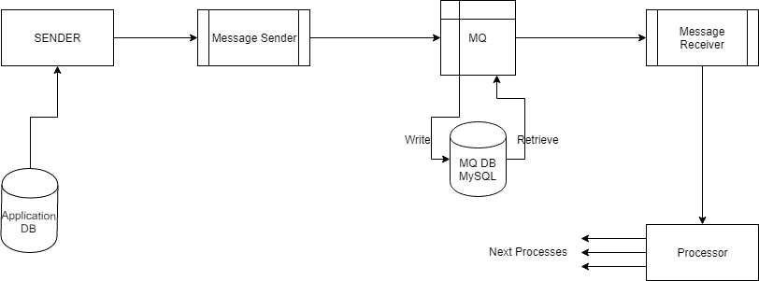
System Design

Slide 5
Active MQ
Version – 5.15.9
Broker URL – tcp://localhost:61616
Web Console – http://localhost:8161
DB: MySQL
Schema: activemq
DB URL: mysql://localhost:3306/activemq

Slide 6
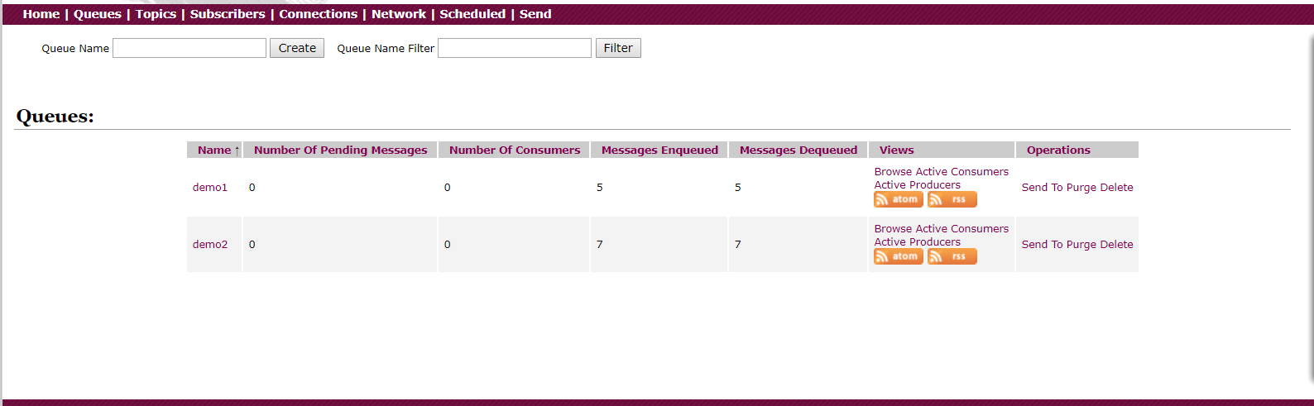
Active MQ – Web console

Slide 7

Active MQ – After Enqueue

Slide 8
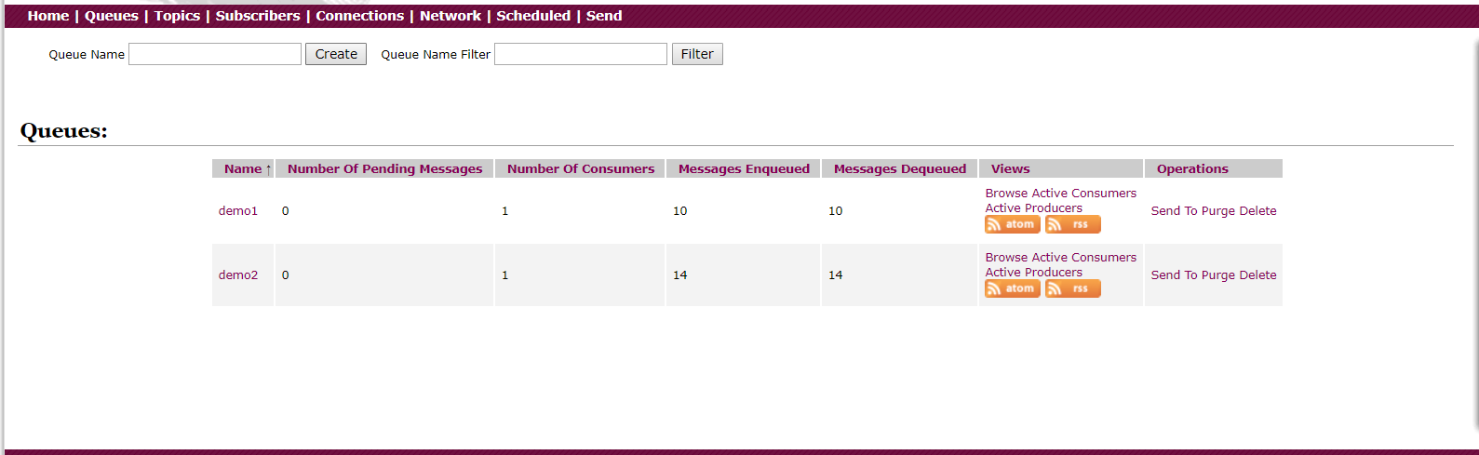
Active MQ – After retrieve

Slide 9
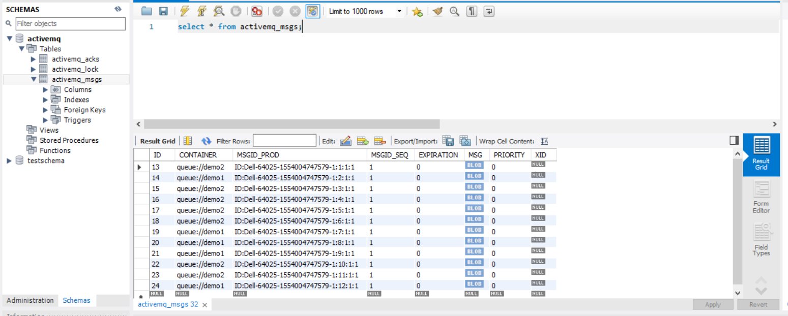
DB Support

Slide 10
Demo
Let’s demo the application.

Slide 11
Q & A
Questions?

